Slide 1


DDS for 5G/6G Cellular Network Calibration and Ranging
Teams Members:
Ahmed Hossam Rafik
Ahmed Haitham Othman
Abdelrahman Khaled Fouad
Mohamed Ahmed Mohamed
Mohamed Adel Abdelrahem
Moustafa Saad Dawood
Youssef Mohamed Mamdouh
Supervision:
Dr. Maged Ghoneima
Dr. Ahmed Mehanna
ADI Digital Team

Slide 2
Agenda
Intro: Abdelrahman Khaled Fouad Abdelrahim
DDS: Ahmed Hossam Rafik Elgamal
OFDM 1sT part: Moustafa Saad Dawood
OFDM 2nd part: Mohamed Adel Abdelrahem
Chirp and TDM: Ahmed Haitham Othman Othman
FDM and overlapping BW: Youssef Mohamed Mamdouh
FFT, IFFT & conclusion: Mohamed Ahmed Mohamed Hussein

Slide 3
Intro: Abdelrahman Khaled Fouad

Slide 4
Main idea of the project
What is DDS ?
Direct Digital Synthesis (DDS) is a digital technique used to generate precise analog waveforms—most commonly sine waves—using digital circuitry.
Key points:
Uses a fixed reference clock and digital processing to generate output signals Provides fine frequency, phase, and amplitude control.
Enables fast frequency switching with high resolution.
Commonly implemented using: Phase accumulator and Lookup table (LUT).
Digital-to-Analog Converter (DAC) Applications:
Signal generators.
Communication systems.
Radar and instrumentation.

Slide 5
Main idea of the project
DDS in ISAC Systems Integrated Sensing and Communication (ISAC) combines wireless communication and sensing (e.g., radar) using shared hardware and signals.
Role of DDS in ISAC:
Generates highly stable and agile waveforms for both sensing and communication
Supports frequency hopping and phase-coherent signals, essential for radar sensing
Enables flexible waveform design, allowing one system to serve dual purposes
Improves spectral efficiency and reduces hardware complexity
Why DDS is important for ISAC:
Precise control → accurate sensing
Fast reconfigurability → adaptive communication
Digital implementation → easy integration with modern DSP systems

Slide 6
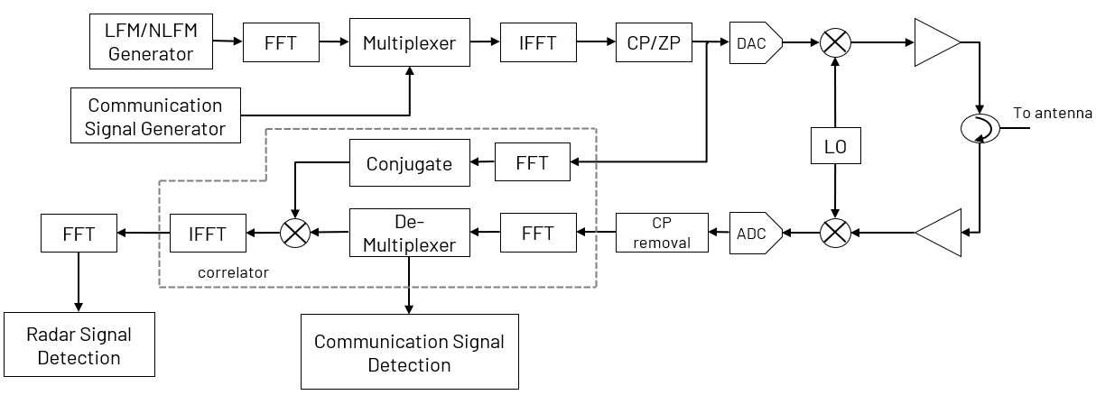
ISAC block diagram
Integrated sensing and communication

Slide 7
What are we going to implement
FFT
IFFT
DDS “direct digital synthesis’ or “LFM generator”
Correlator
we have studied the main concepts in communication and sensing, learned about the DDS and intend to do its modeling, RTL design, verification and ASIC implementation if there is enough time.

Slide 8
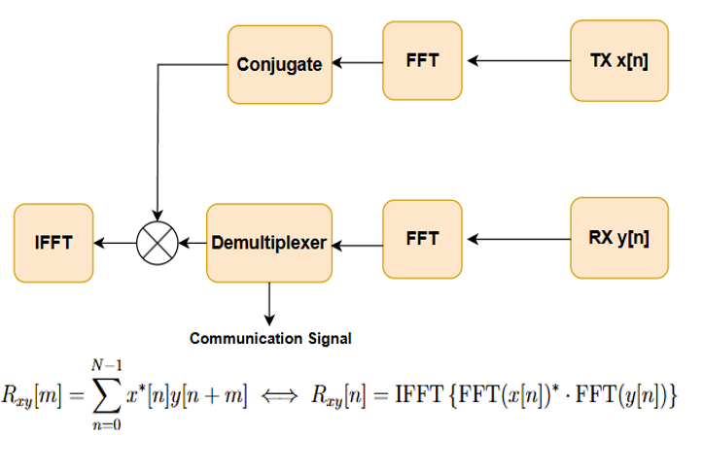
Correlator
Implementation follows a specific digital signal processing sequence:
Reference Branch: Takes the digital signal post-IFFT,
applies an FFT and then performs a Conjugate operation.
Signal Branch: Receives the echo signal and
applies an FFT.
Mixing: The two signals are multiplied in the
frequency domain.
Time-Domain Conversion: An IFFT is applied to the
product to generate the correlation peak In
the time domain for detection.

Slide 9
DDS: Ahmed Hossam Rafik

Slide 10
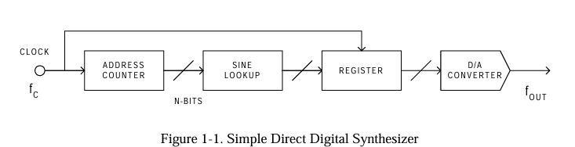
DDS simple block diagram
DDS is a digital method to create any desired frequency based on single stable master clock.
Pros | Cons
Extremely fine controllability | Spurious Emissions
Instant frequency change | Power Consumption at High Speeds
Phase continuity | Bandwidth Limitation

Slide 11
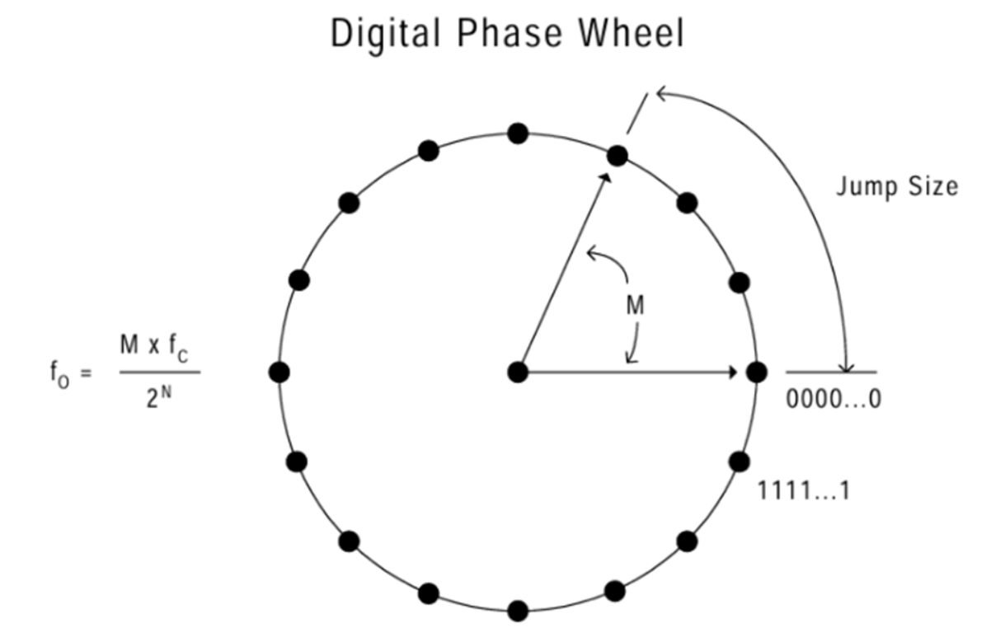
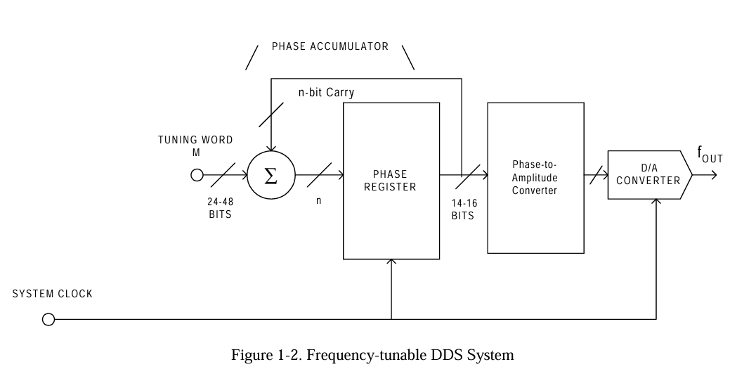
DDS simple block diagram
DDS simple block diagram

Slide 12
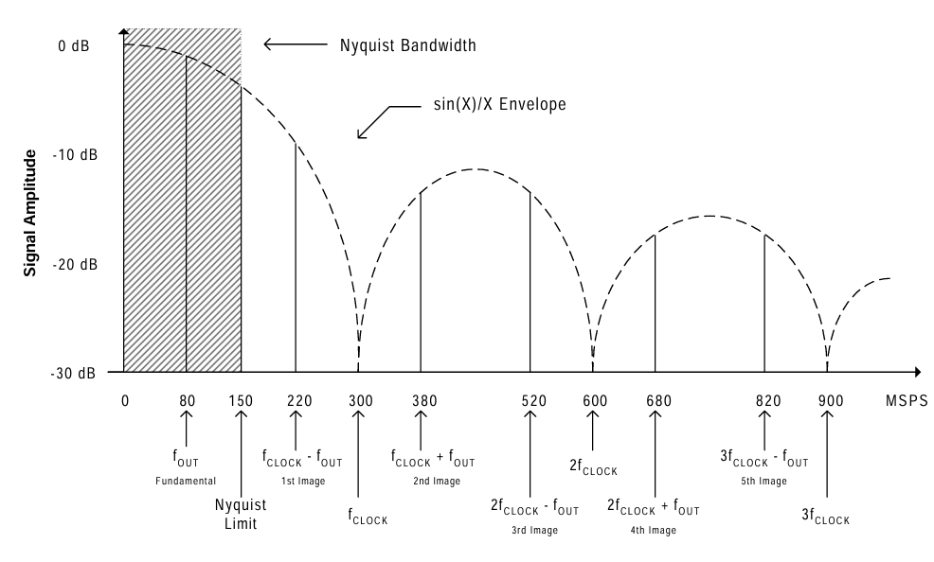
DDS sampled output
The Limit: The
Theoretical maximum output frequency is half the clock frequency (fclk/ 2).
Practical Reality: In the real world, you can only use about 33% of the clock frequency
DDS sampled output
A DDS works by sending digital samples of a sine wave (from the lookup table) to a DAC.
Each clock pulse produces one sample → that means the output is discrete in time, not continuous.

Slide 13
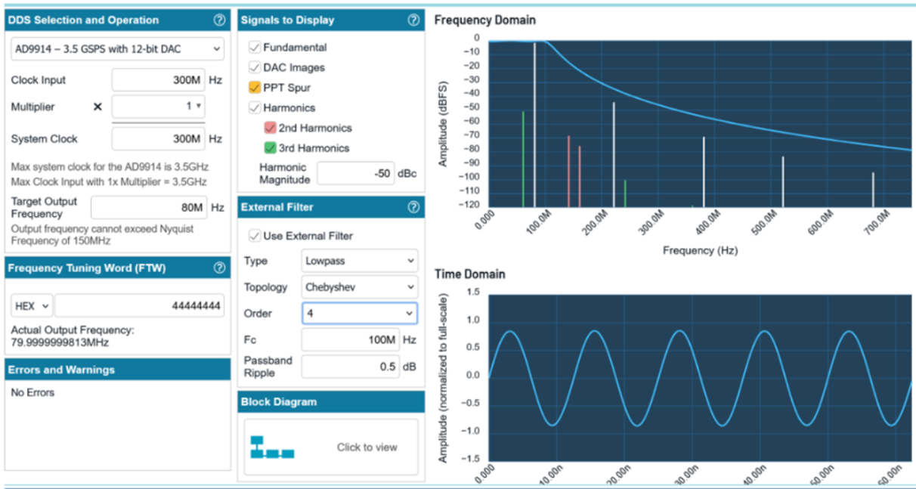
DDS sampled output from ADI tool

Slide 14
OFDM 1st part: Moustafa Saad Dawood

Slide 15
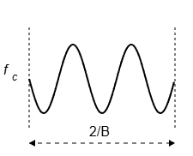
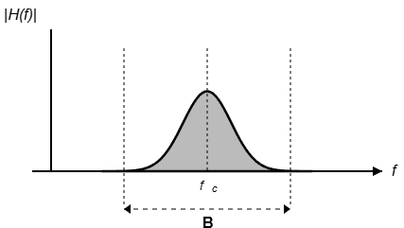
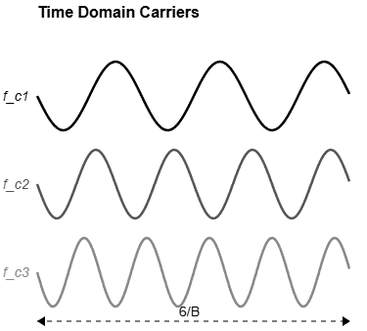
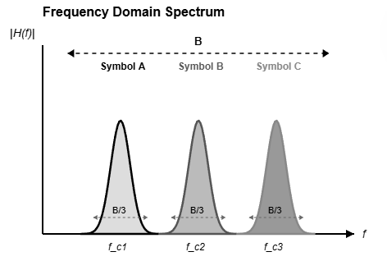
Main concepts “OFDM”
OFDM, or Orthogonal Frequency Division Multiplexing, is a key digital communication scheme. It functions as both:
A Modulation Technique: It transmits data over many closely spaced, orthogonal subcarriers to Solve the problem of frequency-selective fading.
A Multiplexing Technique: It efficiently shares the channel's time and frequency resources among multiple data streams or users
Problem - Frequency-Selective Fading:
In time domain, the channel has a multi-path impulse response.
Convolution of a fast signal with this response causes Inter-Symbol Interference (ISI).
Symbol energy disperses, smearing into neighboring time slots.
Old Solution - Low Data Rate:
Use a slow, narrowband signal where symbol duration >> channel delay spread.
Channel appears flat across this narrow bandwidth.
Pro: Simple single-tap equalizer suffices.
Con: Very low spectral efficiency (wastes bandwidth)
Multi-Carrier Modulation (MCM)
Multi-Carrier Modulation (MCM) solves that problem by,
instead of transmitting one fast symbol over a wide,
distorted channel, transmitting many slow symbols in
parallel over narrow, flat sub-channels

Slide 16
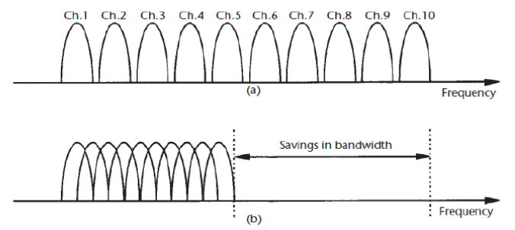
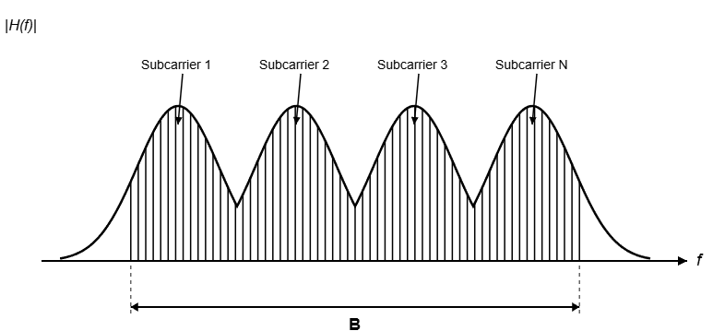
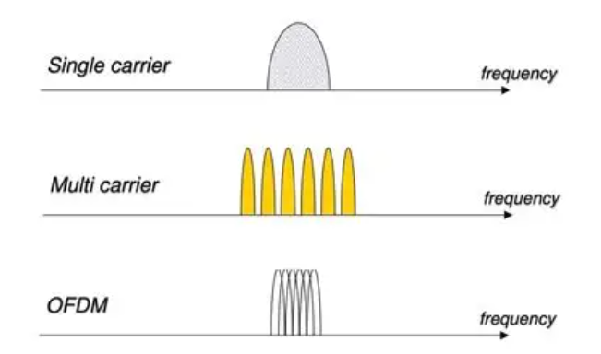
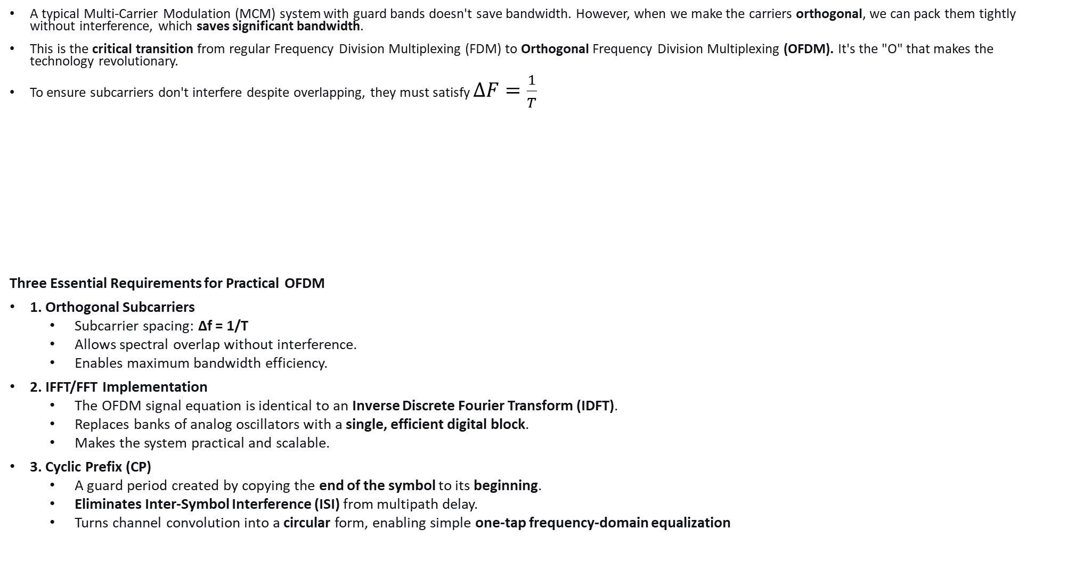
Main concepts “OFDM”
A typical Multi-Carrier Modulation (MCM) system with guard bands doesn't save bandwidth. However, when we make the carriers orthogonal, we can pack them tightly without interference, which saves significant bandwidth.
This is the critical transition from regular Frequency Division Multiplexing (FDM) to Orthogonal Frequency Division Multiplexing (OFDM). It's the "O" that makes the technology revolutionary.
To ensure subcarriers don't interfere despite overlapping, they must satisfy $ΔF=\frac{1}{T}$
Three Essential Requirements for Practical OFDM
1. Orthogonal Subcarriers
Subcarrier spacing: Δf = 1/T
Allows spectral overlap without interference.
Enables maximum bandwidth efficiency.
2. IFFT/FFT Implementation
The OFDM signal equation is identical to an Inverse Discrete Fourier Transform (IDFT).
Replaces banks of analog oscillators with a single, efficient digital block.
Makes the system practical and scalable.
3. Cyclic Prefix (CP)
A guard period created by copying the end of the symbol to its beginning.
Eliminates Inter-Symbol Interference (ISI) from multipath delay.
Turns channel convolution into a circular form, enabling simple one-tap frequency-domain equalization

Slide 17
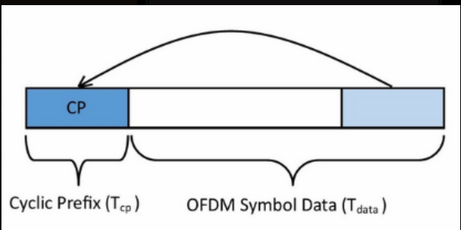
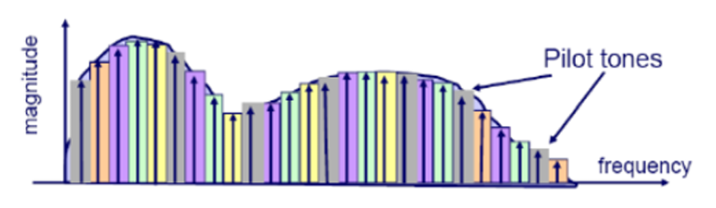
Cyclic Prefix in OFDM
The Cyclic Prefix is a copy of the end of an OFDM symbol placed at its beginning.
Its main jobs are:
Combat Inter-Symbol Interference (ISI): It acts as a sacrificial buffer against signal echoes (multipath) from the previous symbol.
Maintain Orthogonality: It helps preserve the mathematical orthogonality between subcarriers, preventing Inter-Carrier Interference (ICI).
IT eliminates ISI but increased the length so decreased the Data rate
Pilot Tones in OFDM
Specific subcarriers reserved for transmitting known reference symbols
Inserted at regular intervals in time and frequency

Slide 18
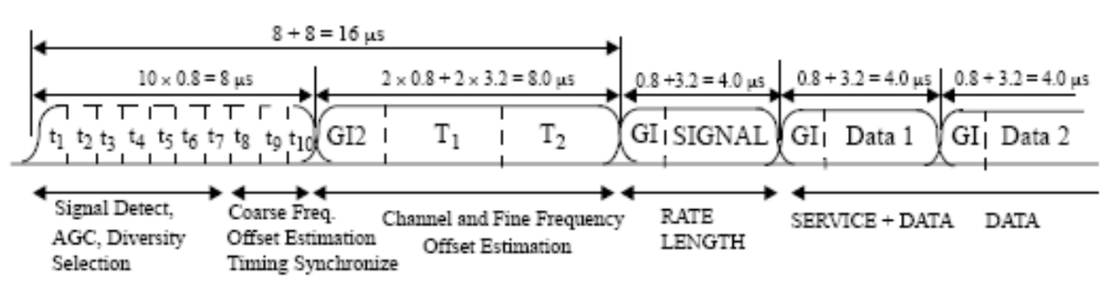
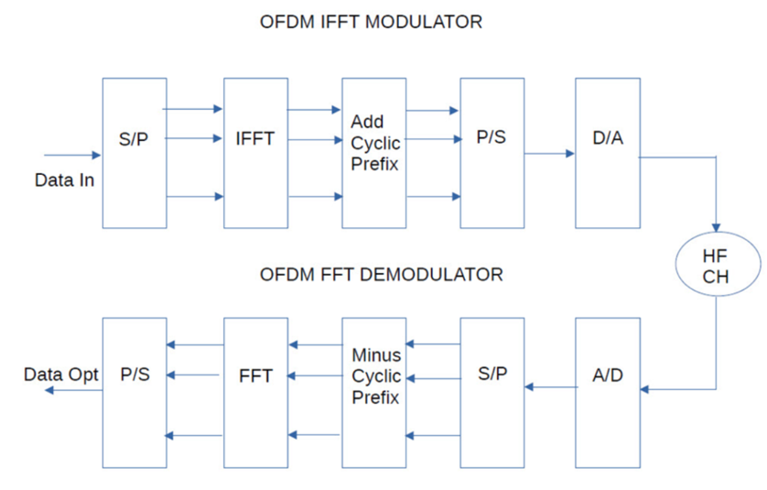
OFDM Frame Structure
Three Main Parts:
Preamble – Synchronization & Initial Estimation
Signal Field – Frame Control Information
Data Field – Payload with Embedded Pilots
OFDM diagram

Slide 19
OFDM 2nd part: Mohamed Adel Abdelrahem

Slide 20
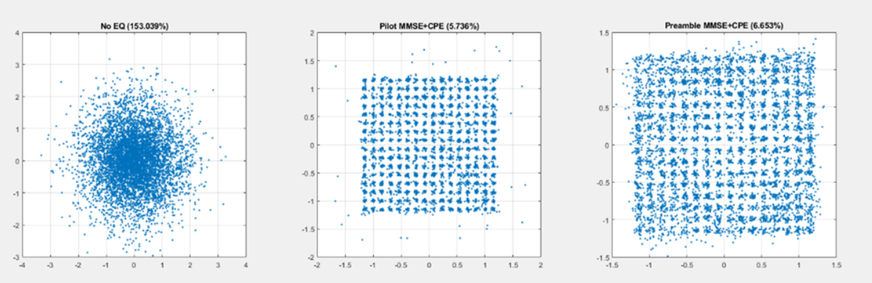
Main concepts “EVM in OFDM”
Error vector magnitude is the distance of the received wrong point in constellation diagram from the correct one.

Slide 21
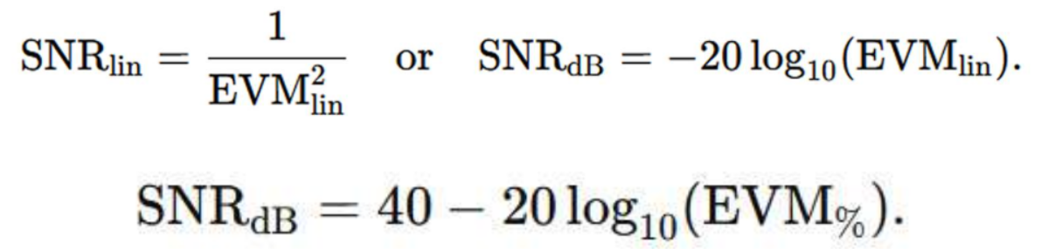
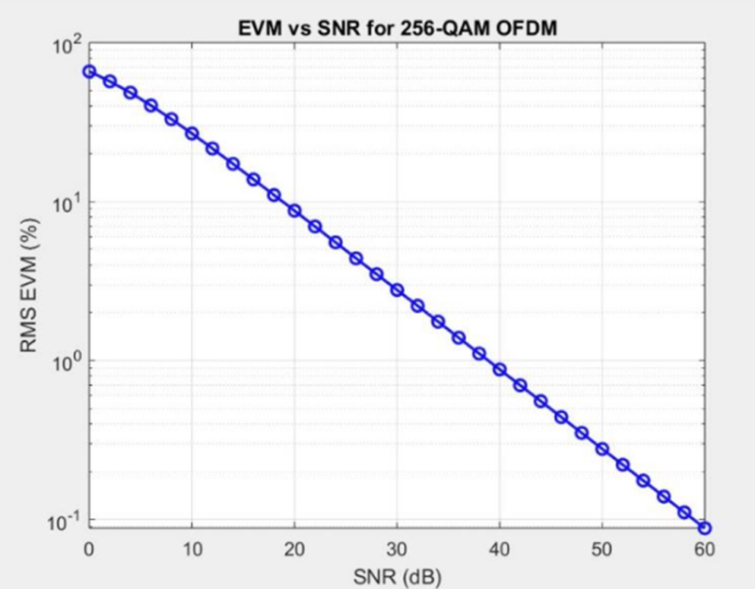
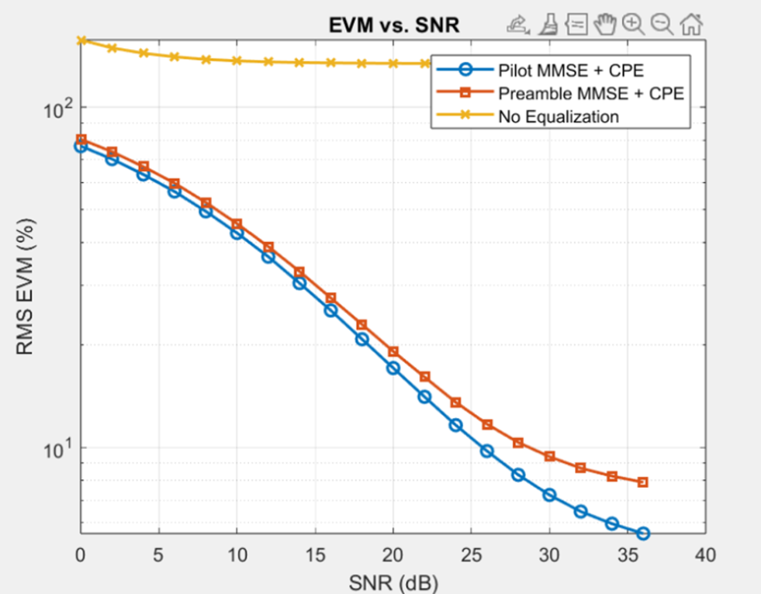
Main concepts “EVM in OFDM”
Approximate equation from the simulation.

Slide 22
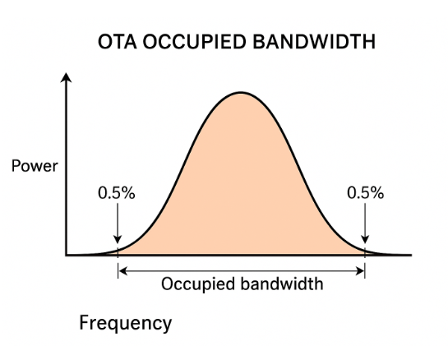
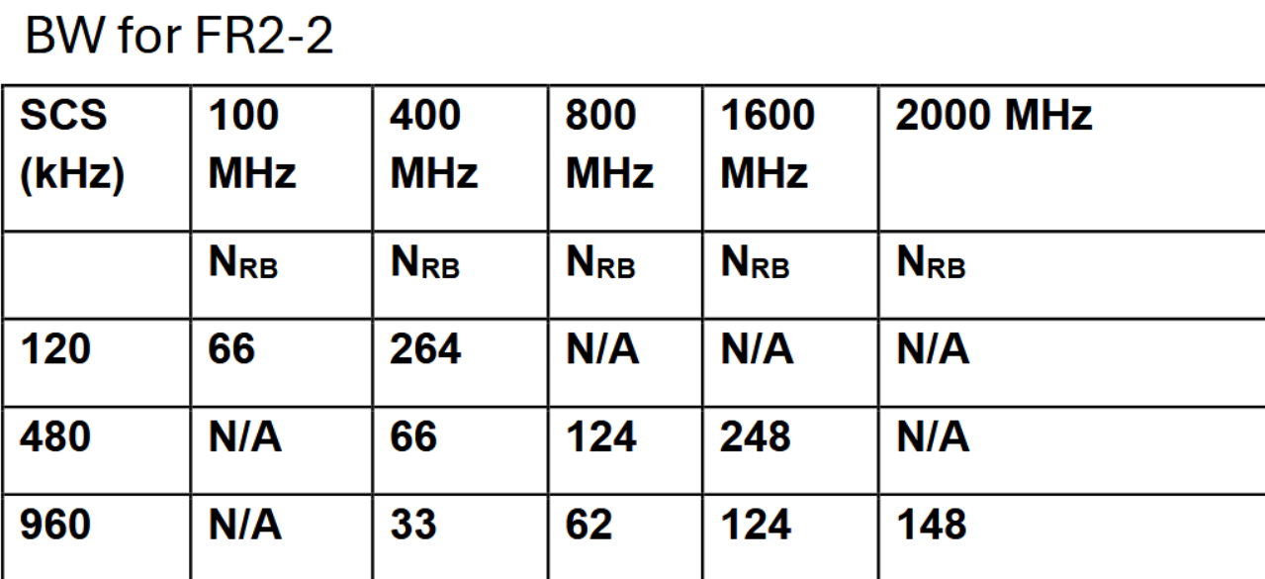
Main concepts “BW, ACLR”
BW: The OTA occupied bandwidth is the width of a frequency band such that, below the lower and above the upper frequency limits, the mean powers emitted are each equal to a specified percentage β/2 (0.5 %) of the total mean transmitted power.
ACLR : Adjacent Channel Leakage Power Ratio :It is the ratio of the filtered mean power (Power after applying a measurement filter (like: BPF) that isolates one channel) centered on the assigned channel frequency to the filtered mean power centered on an adjacent channel frequency.

Slide 23
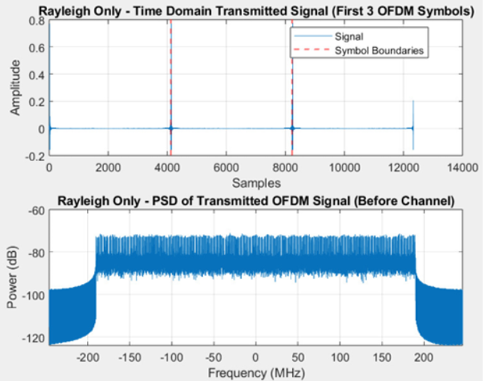
Main concepts “OFDM”
Matlab Simulation for OFDM in FR-2.
%% ---------------- Parameters ----------------
NFFT = 4096;
SCS = 120e3; % Subcarrier spacing [Hz]
NumSCinRB = 12;
NusedFFT = 264 * NumSCinRB; % active subcarriers
NGuardSC = NFFT - NusedFFT;
NSymbols_data = 100; % number of data symbols
% number of identical preamble OFDM symbols (will average)
numPreamble = 3;
% OFDM modulator NumSymbols
totalSymbols = numPreamble + NSymbols_data;
ModOrder = 256; % 256-QAM

Slide 24
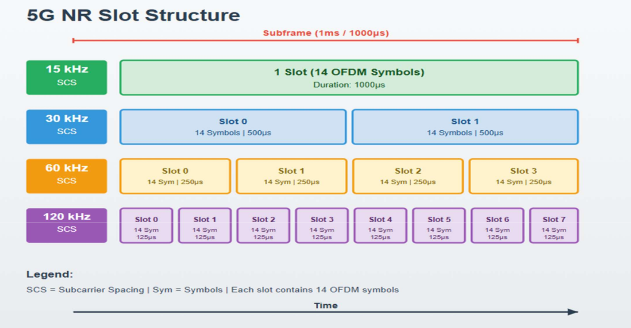
Main concepts “5G frame structure”

Slide 25
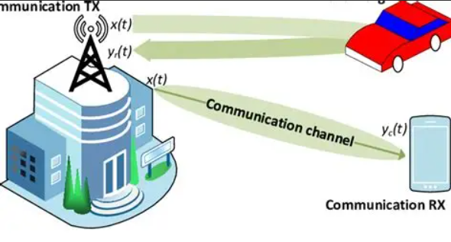
Main concepts “JCAS”
Joint communication and sensing
JCAS makes 6G systems act like a pair of “eyes and mouth” in one device — they can talk and sense at the same time, using the same signal. This leads to smarter, faster, and more efficient wireless networks capable of understanding and reacting to the physical world.
JCAS waveforms can be designed to favor communication (OFDM-based), favor radar (chirp-based), or jointly optimize both depending on the use case.

Slide 26
Chirp and TDM: Ahmed Haitham Othman

Slide 27
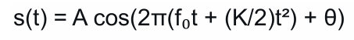
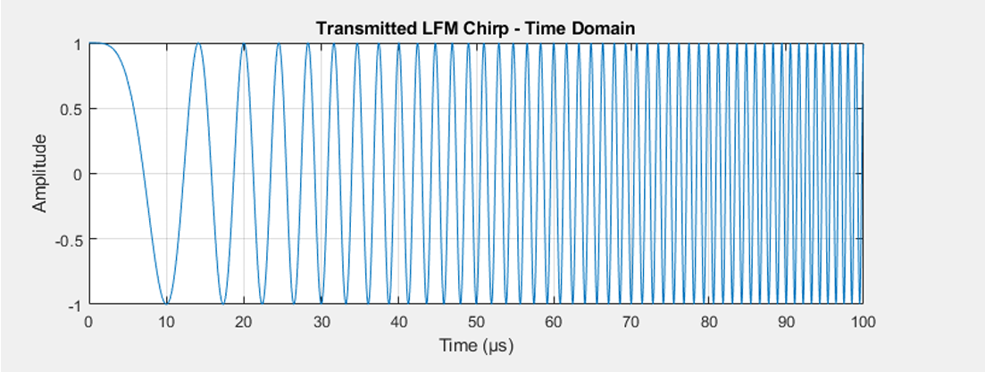
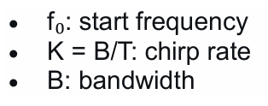
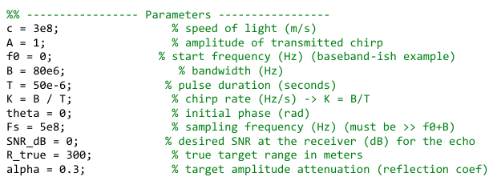
Main concepts “Chirp signal”

Slide 28
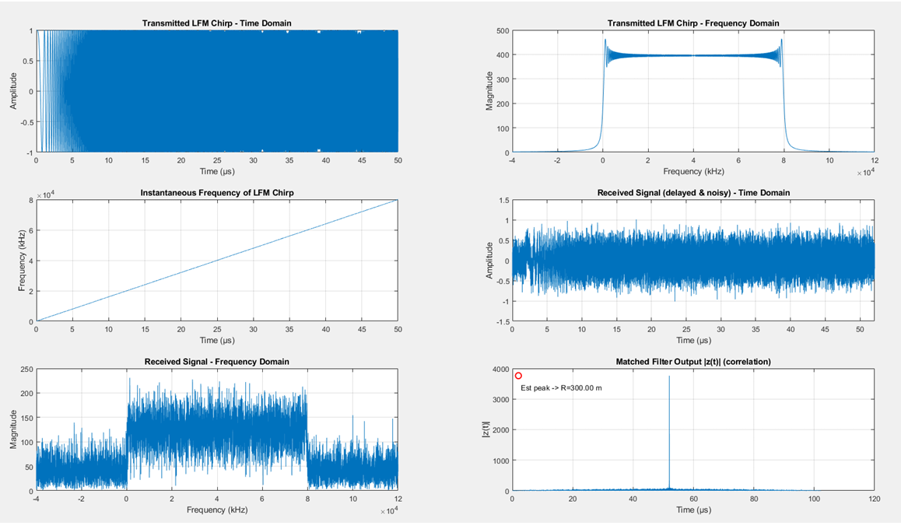
Main concepts “Chirp signal”

Slide 29
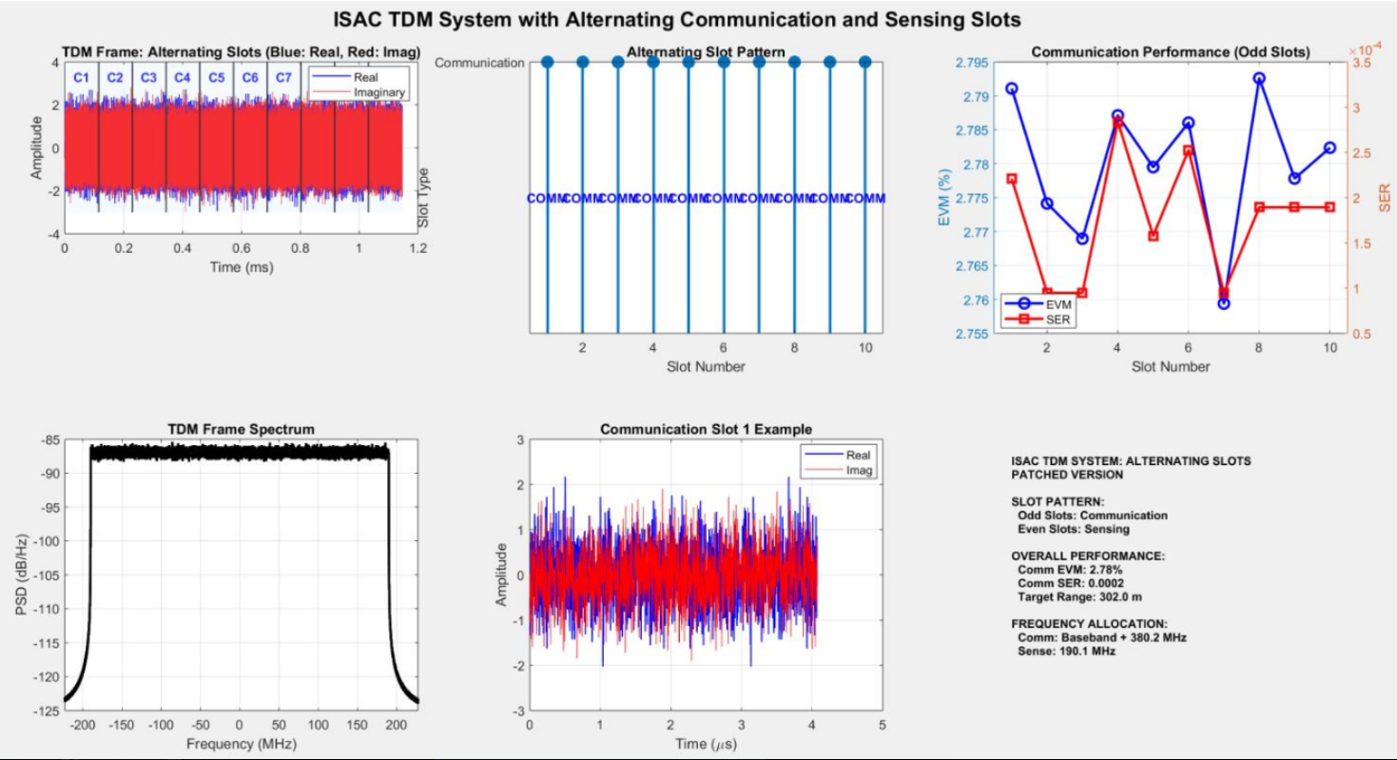
Main concepts “TDM”
OFDM + Chirp (different timeslots).

Slide 30
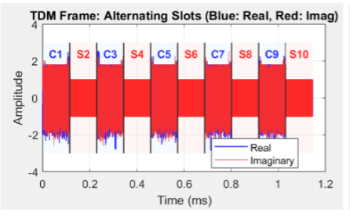
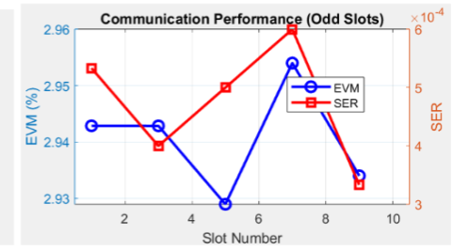
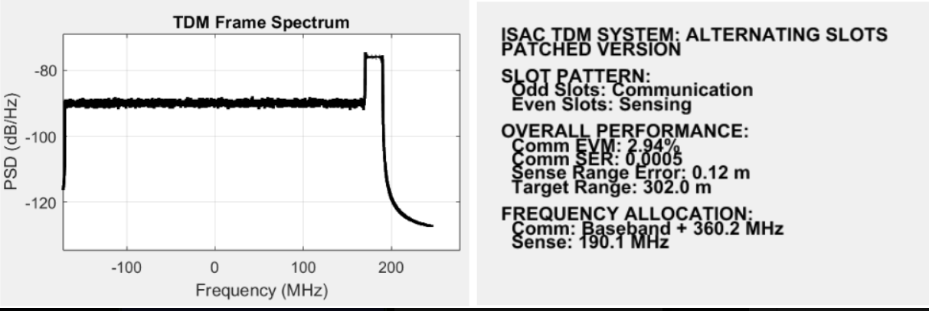
Main concepts “TDM”

Slide 31
FDM and overlapping BW: Youssef Mohamed Mamdouh

Slide 32
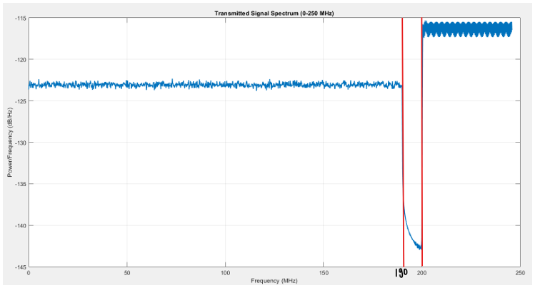
Main concepts “FDM”
Sending OFDM communication signals and an LFM radar chirp simultaneously in the same time slot
OFDM BW = 380 MHZ , Chirp BW = 80 MHZ
Guardband = 20 MHZ
If small GB : EVM increases due to leakage of
power from Chirp to OFDM
If GB increases : EVM decreases and ranging is not
affected in either case
SO, EVM is sensitive to guard band size and Radar sensing is robust in both cases
Sensing is affected by channel effects. If there’s AWGN, sensing error is relatively acceptable and if there’s doppler effect, Sensing is affected significantly

Slide 33
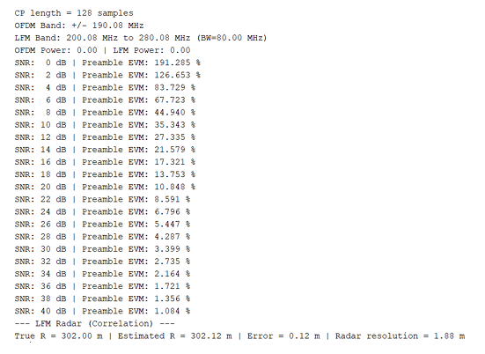
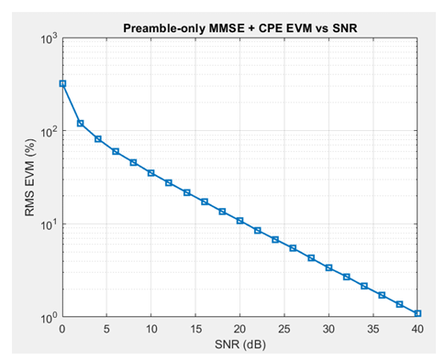
Main concepts “FDM”
By increasing SNR, EVM decreases as noise power is relatively low with respect to signal power

Slide 34
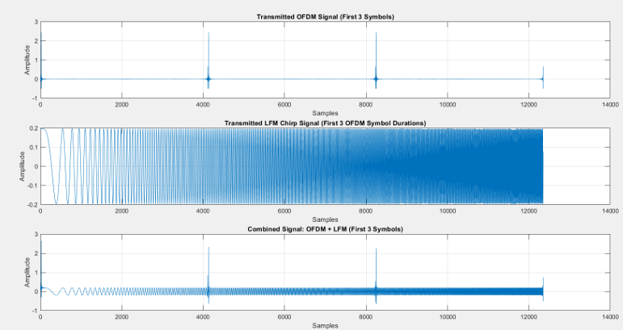
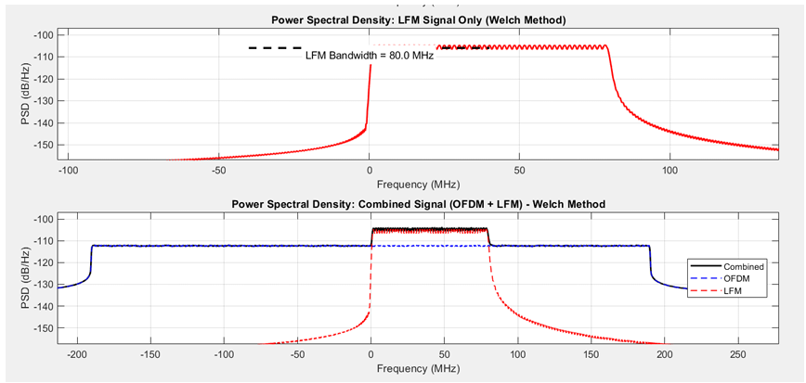
Main concepts “overlapping bandwidth”
The matched filter receives the LFM signal after a time delay and performs correlation between the received LFM and originally transmitted LFM signals
The maximum peak out of correlation represents the right LFM signal after certain time delay which represents the round trip time then distance is calculated by the relation: d = (round trip time * c) / 2

Slide 35
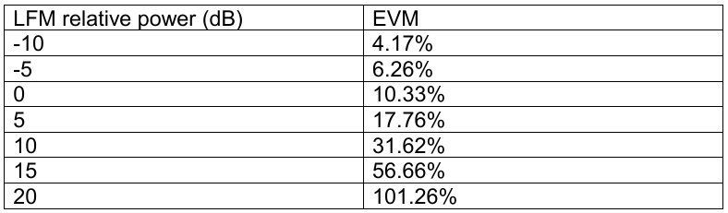
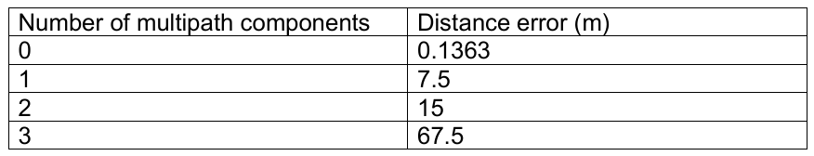
Main concepts “overlapping bandwidth”
if the LFM power is near or higher than the OFDM signal power it will make significant interference with the OFDM symbols at the receiver so, the receiver can’t distinguish them from each other and EVM gets worse
Distance is affected by number of multipath components that face the LFM signal during its propagation through the channel as the transmitter receive replicas of LFM with variable delays and peaks, so it searches for maximum peak that gives the least error in distance calculation

Slide 36
FFT, IFFT & conclusion: Mohamed Ahmed Hussein

Slide 37
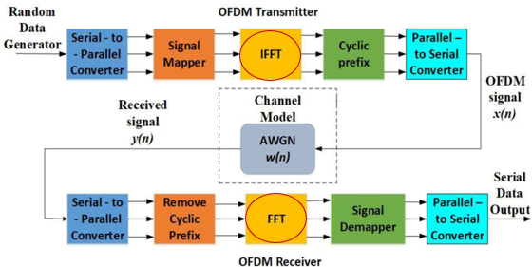
Main concepts “FFT,IFFT”
In modern communication systems—especially OFDM and chirp-based sensing systems,
the Fast Fourier Transform (FFT) is one of the most critical building blocks.

Slide 38
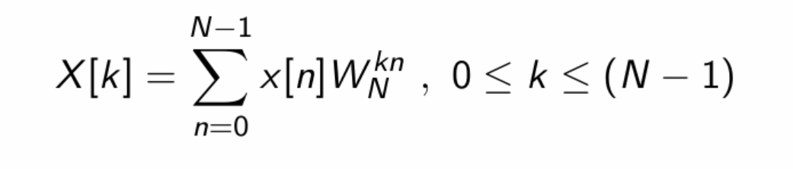
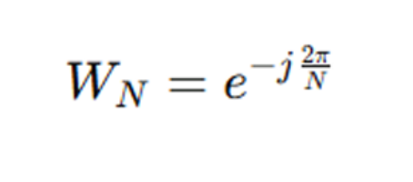
Main concepts “Butterfly operation”
A butterfly is the fundamental building block of the FFT.
The Discrete Fourier Transform (DFT) is given by:

Slide 39
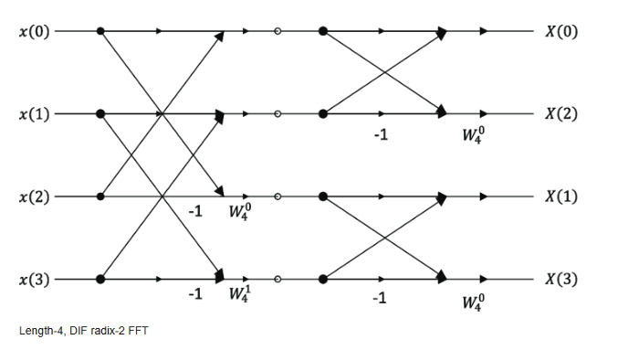
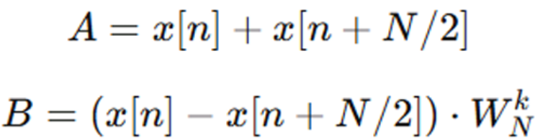
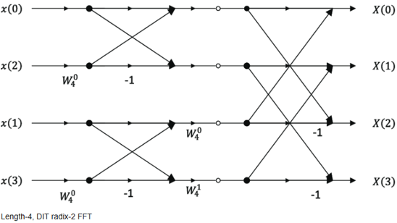
Main concepts “DIF vs. DIT FFT”
Decimation in Frequency (DIF)
Splits the output spectrum into even- and odd-indexed parts.
Bit-reversal applied at the output.
Twiddle factors multiply later.
Decimation in Time (DIT)
Splits input sequence into even and odd indices.
Bit-reversal required at the input.
Twiddle factors multiply early.

Slide 40
Serial Vs. Parallel FFT Architectures
Serial FFT Architecture | Parallel FFT Architectures
Huge area reduction because only one butterfly is reused | Large area
Very efficient for ASIC and FPGA | One FFT per clock (if fully parallel)
Fits low-power or resource-constrained systems | Suitable for high bandwidth systems (5G NR, WiFi 6, radar processing)
Higher latency | Very high throughput
Throughput limited to "one output every clock" after pipeline fill | Higher power consumption & Requires many multipliers + adders

Slide 41


FFT Serial Architectures
These process one sample per clock cycle. They are resource-efficient and ideal for low-to moderate throughput designs.
Serial pipelined architectures include:
1. SDF – Single-Path Delay Feedback
Most widely used low-complexity architecture
Uses feedback registers to store delayed samples
Very area-efficient
2. SDC – Single-Path Delay Commutator
Uses commutators (switch networks) instead
of feedback loops
Often higher throughput than SDF
Regular structure → good for high-speed FFTs

Slide 42

Serial Radix-2² (Radix-22) SDF Architecture
Based on memory efficiency, hardware simplicity, computational savings, and suitability for high-throughput OFDM systems, The radix-22 SDF architecture offers the best balance between performance and implementation complexity.
For a 4096-point serial FFT core in a 6G ISAC system, it is the optimal architecture from both an engineering and research standpoint.

Slide 43


IFFT
The IFFT's job is to transform digital data into a transmittable waveform
It takes parallel frequency-domain QAM symbols and converts them into a serial time-domain signal that can be modulated and sent over the air

Slide 44
Conclusion
We have done the following so far:
Designed a DDS-based waveform generation and correlation system for 5G/6G ISAC applications
Studied ISAC fundamentals and wireless channel effects
Implemented OFDM and analyzed 5G NR standards (FR2)
Evaluated DDS and FFT architectures for hardware suitability
Simulated signal processing strategies (TDM/FDM) in MATLAB
Quantified trade-offs between communication (EVM) and sensing accuracy

Slide 45
Future Work
Finishing the modeling phase we started
Starting RTL Design and Verification for The specified blocks
ASIC Flow and FPGA Prototyping

Slide 46
Timeline
Phase | Weeks | Key Deliverables
Project Kickoff | Week 0 | System overview document
Specs & Architecture | Weeks 1 | DDS specification document
RTL Block Implementation | Weeks 2–6 | Verified RTL blocks
Modeling & Algorithm Validation | Weeks 2–6 | Final golden Model vs spec plots
Integration & System Verification | Weeks 2-8 | Integrated DDS RTL Verification report
FPGA Mapping & Optimization | Week 9 | Timing-closed FPGA design
ASIC flow | Week 10 | Completed ASIC flow of the design
Demo & Documentation | Week 11 | Final report & thesis

Slide 47
Thank You!

